Slide 1
Shockwave - Study of Earthquakes since the 70s
John Burke, Anderson Igben, Ali Chunawala, Stanislav Kuzmin, Henry Wycislo

Slide 2
Agenda
Introduction (Henry)
Background
Is there an increase in earthquakes greater than magnitude 3 since 1970?
Is there an increase in the magnitude of earthquakes since 1970
Earthquake Data
Retrieval Process (Ali)
Clean-Up Methods (John)
Programming Code (John & Stan)
Visualizations and Analysis (All)
Conclusions

Slide 3
Programming Code
Tools:
Pandas - pull from USGS api and filter it
Matplotlib - plot the data
GMAPS - put the data on the map
Github - collaborate with code development

Slide 4
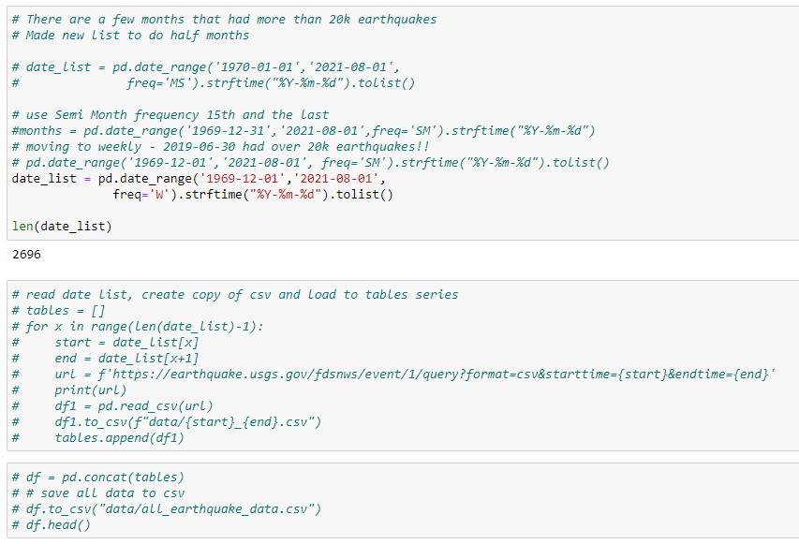
Retrieval Process
Source - USGS website
Created date list from 1970 - Present
With date list created a url to extract one week of earthquake data
Merged all weeks into one DataFrame and saved to CSV

Slide 5
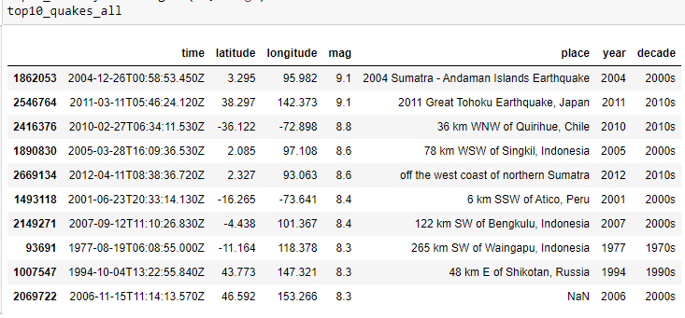
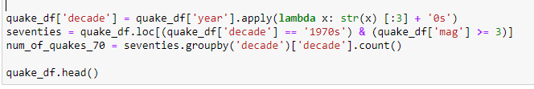
Data Clean-up Method
Dropped all non-essential rows
Created 2 new columns
Year
Decade
Created DataFrames to filter Mag =>3 & by decade
Created DataFrames for top 10 earthquakes for each decade

Slide 6
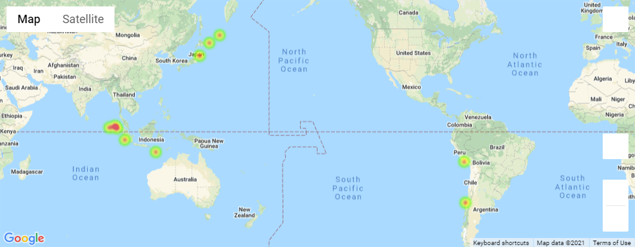
Top 10 Earthquakes All Data

Slide 7
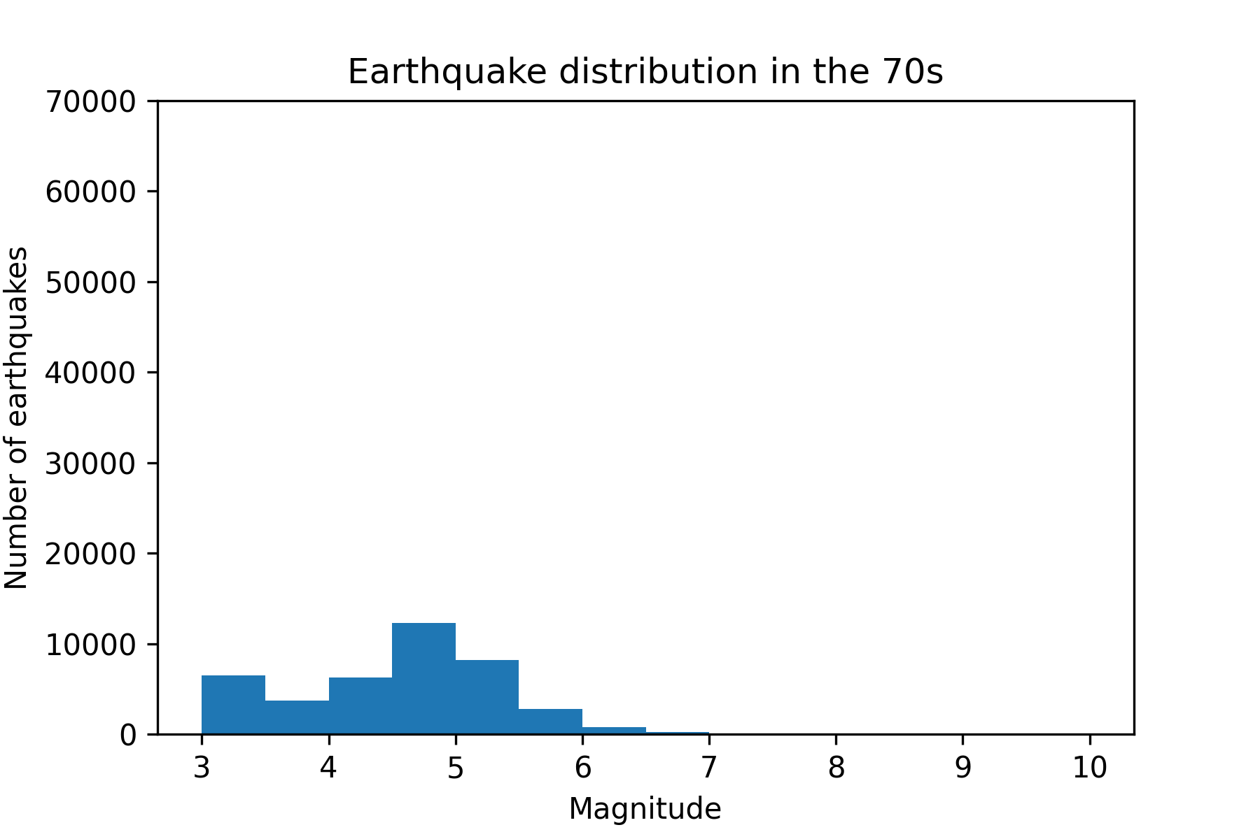
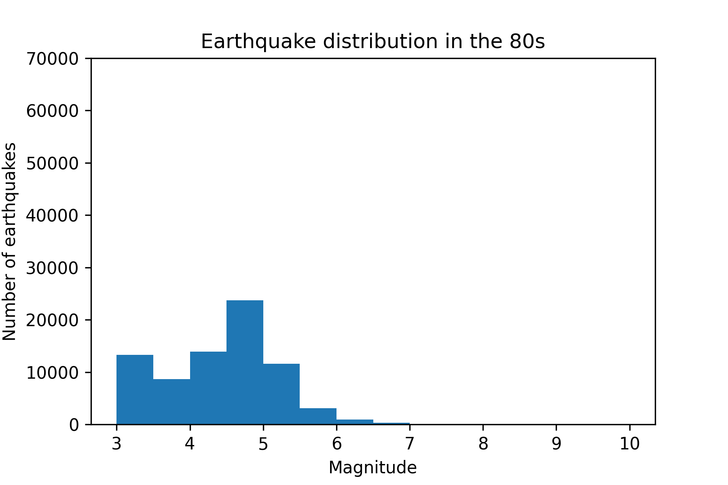
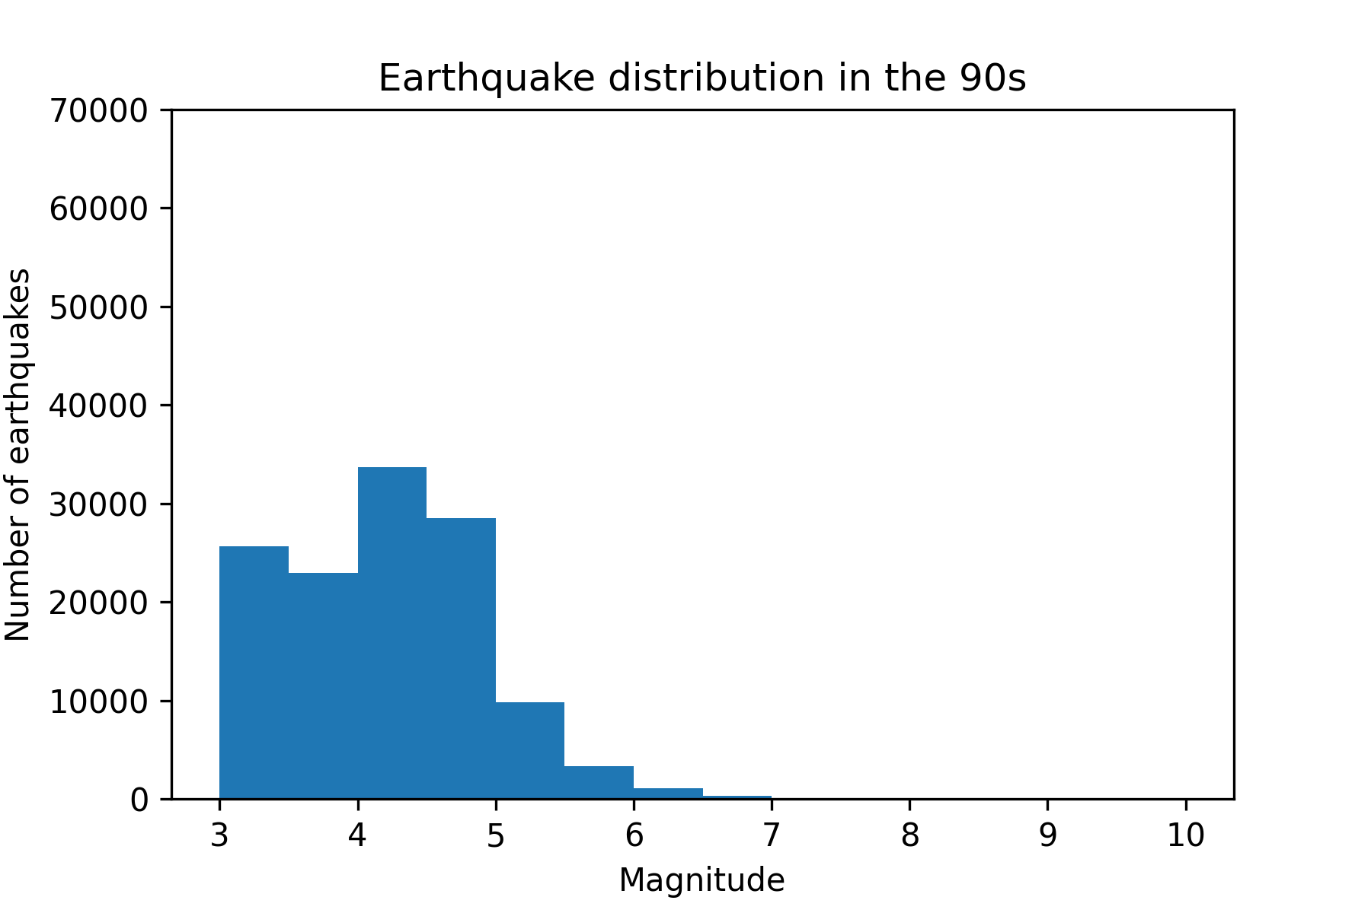
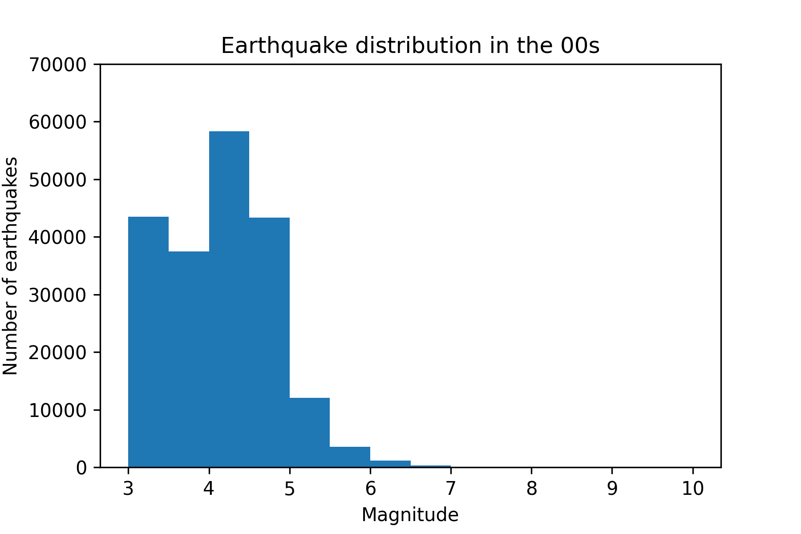
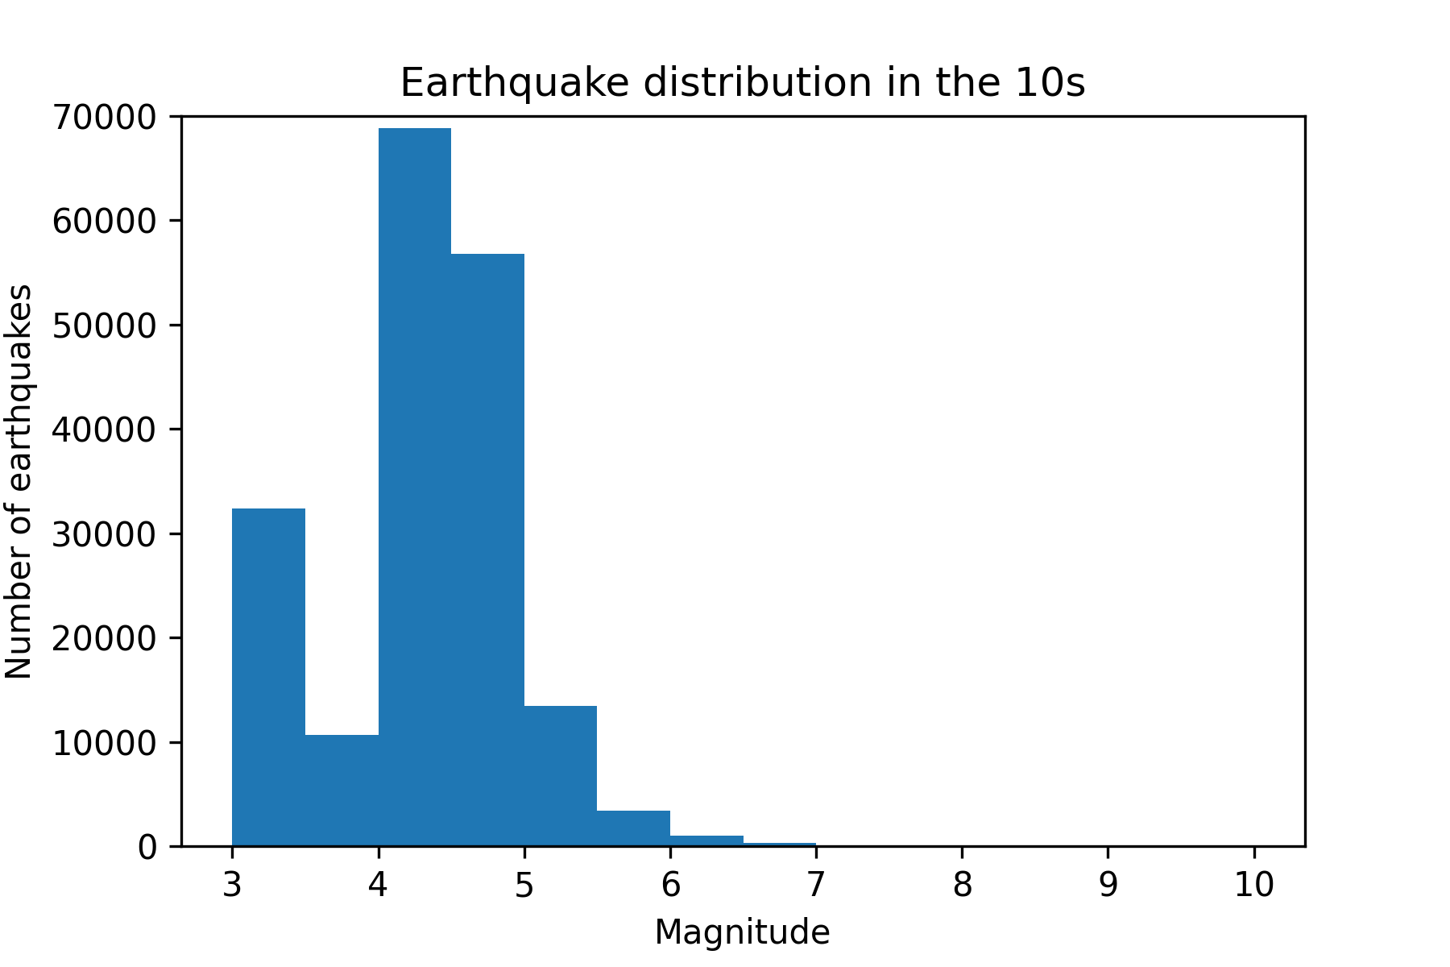
Distribution of earthquakes over magnitude for past decades
Number of registered earthquakes with Mag>3 grows each decade
There is a bimodal distribution with two peaks - one at zero (cut out) and one at Mag~4.5

Slide 8
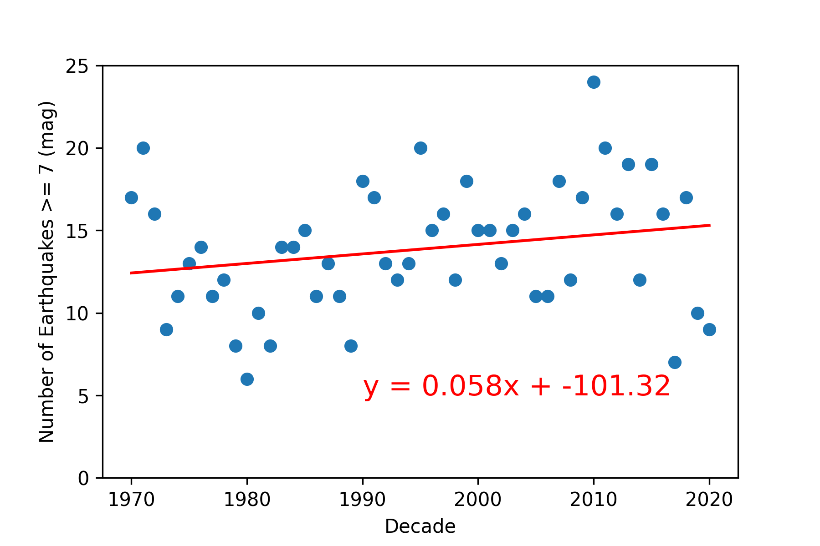
Number of earthquakes of magnitude>7 versus time
R=0.22
P value =0.118
Although the slope is positive, we cannot reject the null hypothesis

Slide 9
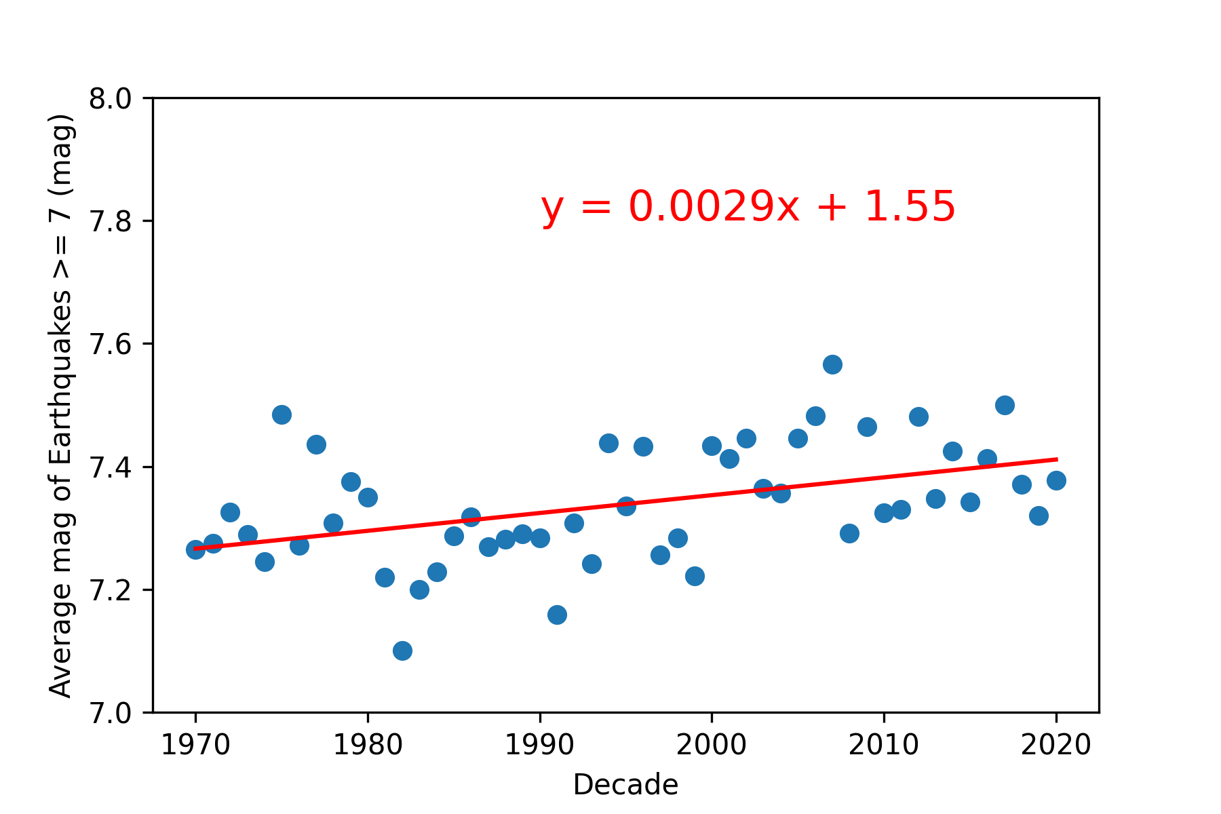
Magnitude of earthquakes of magnitude>7 versus time
R=0.45
P value= 0.00086
There is a trend of growing average magnitude over 50 years.
The slope is very small

Slide 10
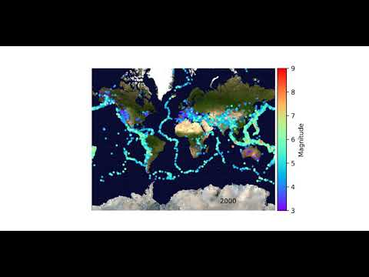
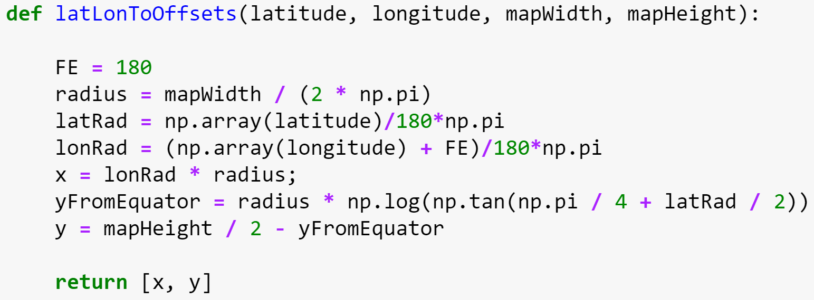
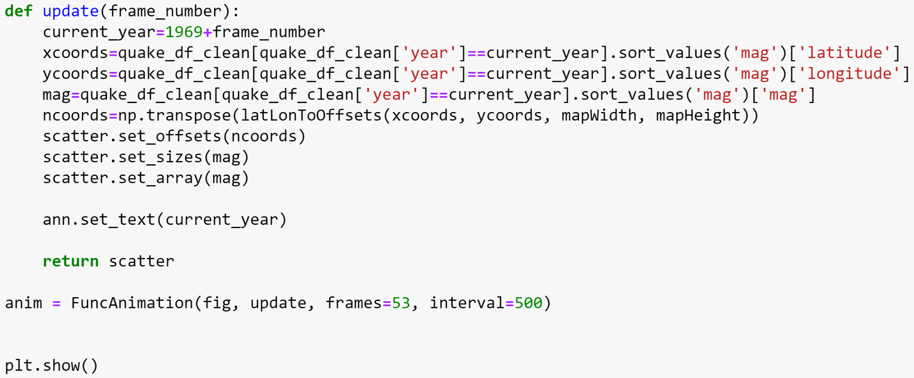
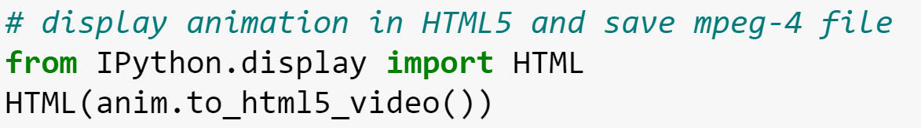
Earthquakes with Mag>3 registered each year
Coordinate conversion from lat-lon to x-y pixels of the image:
Animate scatter plot:
Render animation to HTML5 and mpeg file:

Slide 11
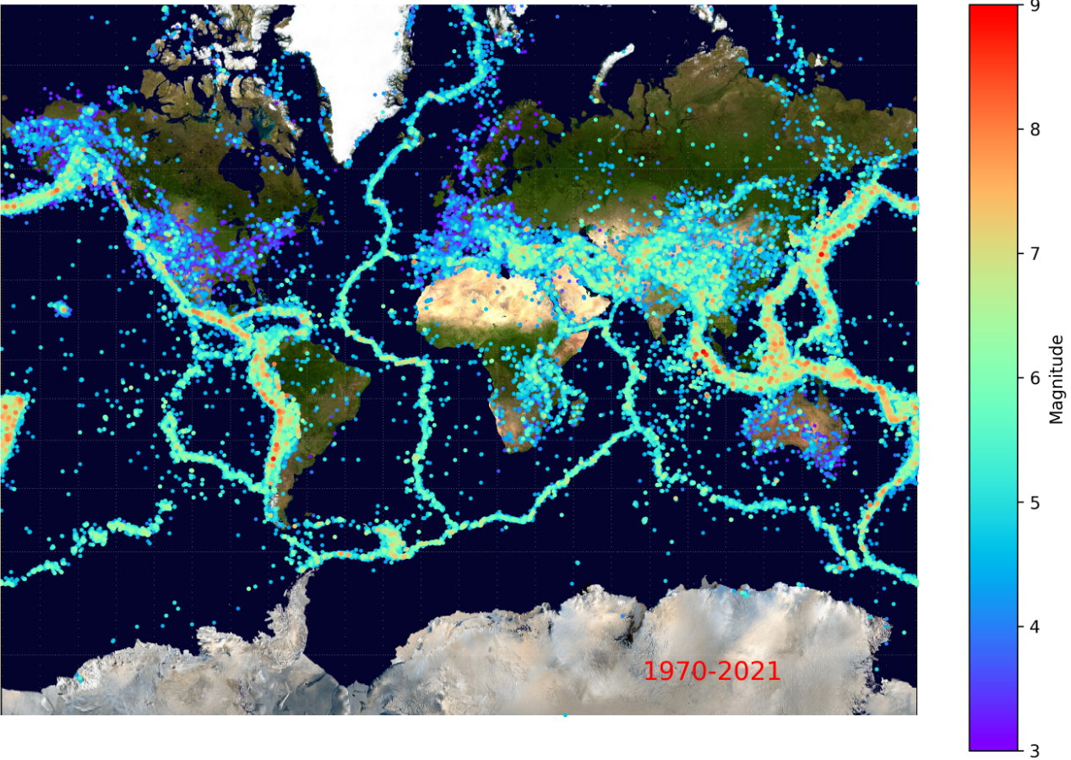
Conclusions
Number of earthquakes per year slightly increased over 50 years
Magnitude of earthquakes slightly increased
Earthquakes concentrate in seismically active areas of the earth associated with tectonic plates boundaries

